Slide 1
RX and TX Techniques
Week 4

Slide 2
Review
During Weeks 1 and 2, we briefly discussed how transmitting and receiving radio signals work, and we also discussed what frequency ranges we’re allowed to transmit in.
This week, we will only be focusing on receiving radio signal. While it is legal to listen to almost every transmission you can receive, it is illegal to divulge information you’re not a party to, or to act on that information in your own self interest.
Essentially, everything that isn’t encrypted is considered “fair game” in the realm of Amateur Radio.

Slide 3
Hardware For This Week
RTL-SDR V4 with Dipole Antenna Kit
Lab Computer or Device with OS of your choice
The RTL-SDR is a popular hardware device that can receive wireless signals. It can receive signals from 500 kHz up to 1.75 GHz.
The RTL2832U chip used in the RTL-SDR is an analog to digital converter that samples the baseband signal and outputs the samples to your computer via USB.

Slide 4
Software For This Week
SDR# is a Digital Signal Processing application for Software Defined Radios (like the RTL-SDR).
Digital Signal Processing (DSP) refers to the various techniques for improving the accuracy and reliability of digital communication. Some of these techniques include:
Compression / Decompression
Filtering / Equalization
Modulation / Demodulation

Slide 5
DSP Techniques - Compression / Decompression
Compression is the process of increasing the quality or quantity of the signal parameters transmitted.
For example, Dynamic Range Compression boosts the volume of sound while reducing the dynamic range of source audio.
Compression can also remove the ‘ess’ sounds from voice transmission, and can increase transmitted signal strength.
Decompression: is simply the process of restoring compressed data to its original form.

Slide 6
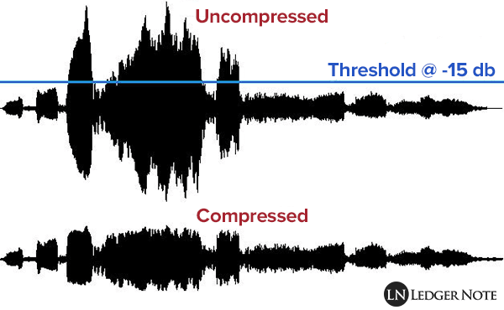
Compression (Visualized)

Slide 7
DSP Techniques - Filtering
Filtering allows your radio receiver to only pick up the desired signal or signal volume while rejecting all other signals or volumes.
Example 1: FM operates on a bandwidth of 200 kHz, but say you find an FM signal that’s only 50 kHz wide. You’d be getting an additional 75 kHz of extra “stuff” on both sides of the FM signal. You could then choose to “filter” the bandwidth size (Stopband) to only pick up the desired signal (Passband.)
Example 2: If you’re listening to a station that has static at -30dB, but people occasionally talk at -20dB, you could set a Noise Reduction Filter at -30dB to remove a good portion of the static, while preserving everything above -30dB.

Slide 8
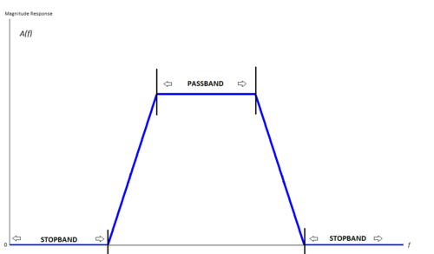
Filtering (Visualized)

Slide 9
DSP Techniques - Equalization
Equalization is the act of adjusting the specific audio frequencies received to achieve a clear and balanced mix. If the signal you’re picking up is too treble heavy, you can use an equalizer to lower or completely remove those high frequency sounds.

Slide 10
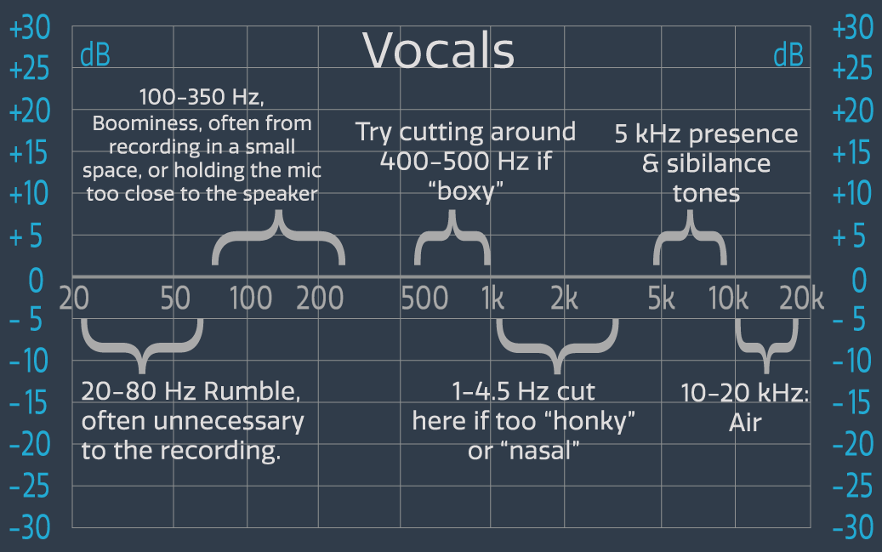
Equalization (Visualized)

Slide 11
DSP Techniques - Modulation / Demodulation
Modulation is the process of converting data into radio waves by adding information to an electronic carrier signal.
Amplitude Modulation (AM) Radio works by changing the height (or intensity) of the signal carrier to represent data being added.
Frequency Modulation (FM) Radio works by changing the frequency of the signal carrier to represent the data being added.
Demodulation works to recover the information content from the modulated signal.

Slide 12
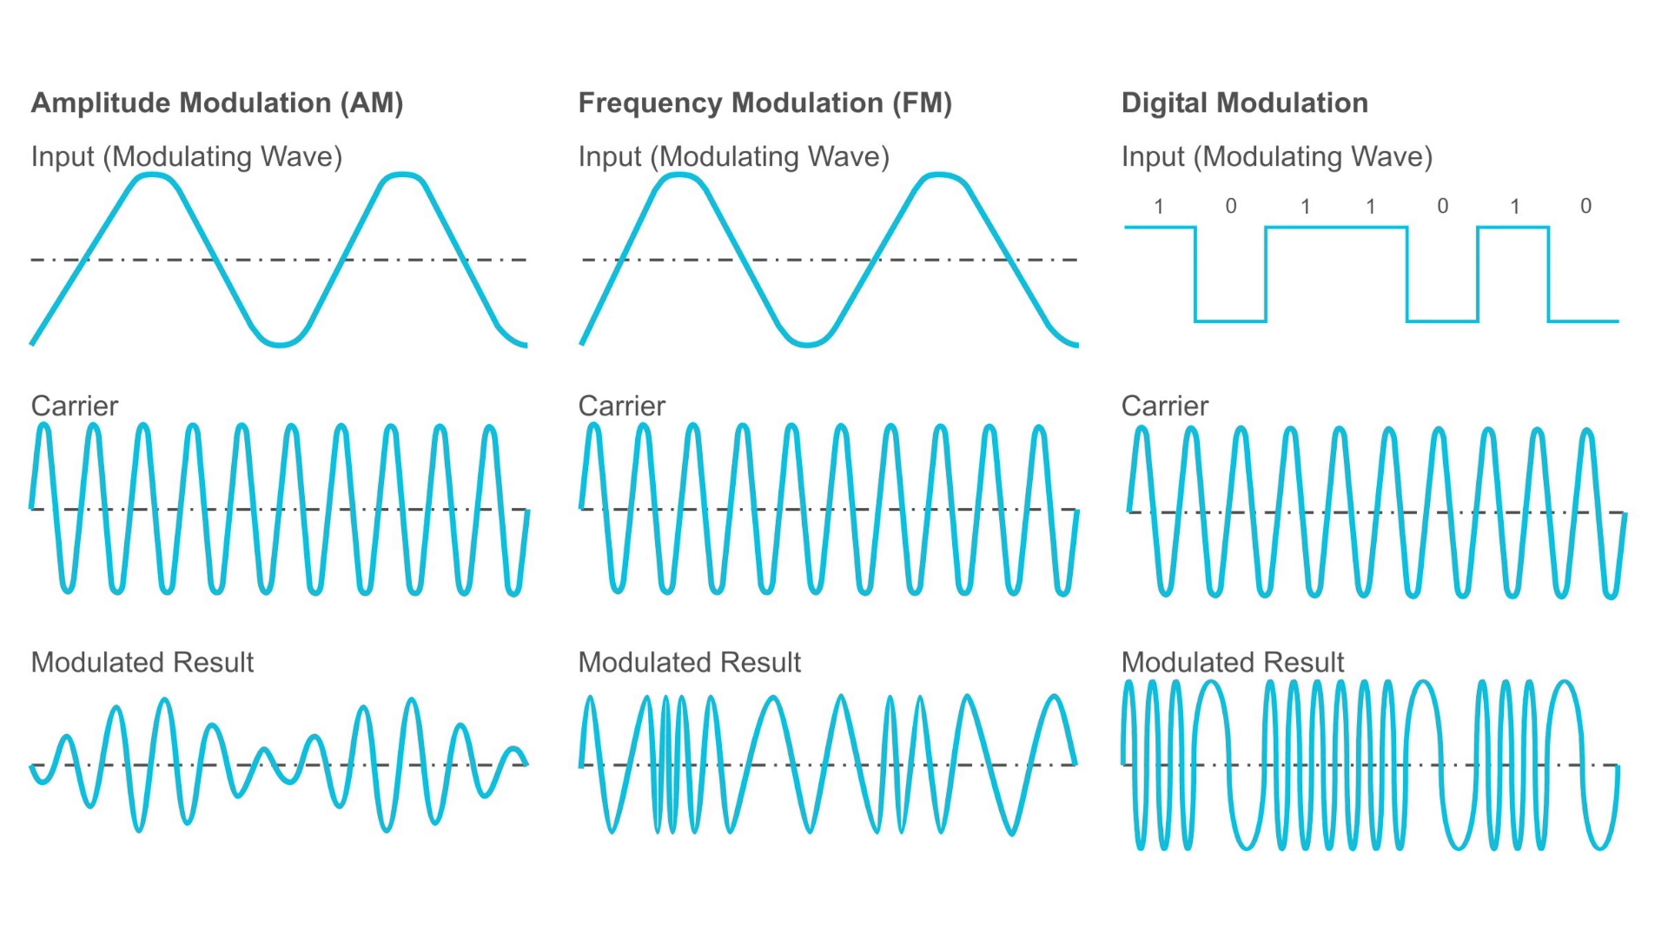
Modulation (Visualized)

Slide 13
This Week’s Lab
Let’s find some radio signals in the wild! Individually or as a group, grab an RTL-SDR kit and follow the Lab Instructions to download the software and drivers needed.
Here are the main questions to focus on:
What’s the frequency you found?
What type of content is being broadcasted? Is it a radio station? Walkie talkie conversation? The BTV Air Traffic Control Tower…? 👀
Is there any Metadata? (Don’t feel like you did something wrong if there isn’t. Most FM Radio stations will have it, but anything outside the realm of music won’t really have anything.)

